Slide 1
Fresh Grads – Group Project
Online Customer Service Center

Slide 2
Problem Statement
Call Centre Process: Within a call centre the main process is handling the telephone call.
If Operator can give the customer all the information, they require during the call without passing it to someone else, then this is usually known as ‘one and done’.
The more calls that can be handled as ‘one and done’ the more efficient the process can be.

Slide 3
Problem Statement
The call handling can be broken down into three steps:
Answering the call by ACD
The time that operator spends talking to the customer
The wrap up time
The wrap time which is anything that the operator has to do with the call after the customer hangs up
The talk time and wrap time combined will give you average call duration, which is key statistic in the centre

Slide 4
Road Map
Application will be developed in following Sprints –
Core Java +JPA with Hibernate
Spring Boot + Rest Controller + JPA with Hibernate
Angular for UI design (Front End) + Integration with previous Sprint

Slide 5
Plan
Design
Generate the skeleton as per class design provided
TDD approach
Identify test cases for each module
Write Failing Test cases
Convert the Test Cases in GREEN
Implement the case study in incremental manner

Slide 6
Modules
Login Module
Customer Module
Operator Module
Admin Module

Slide 7
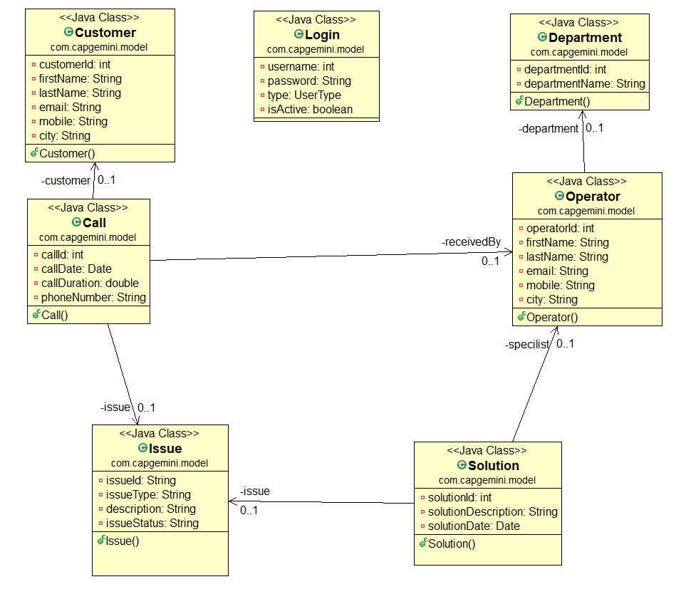
Class Design
POJO Classes:

Slide 8
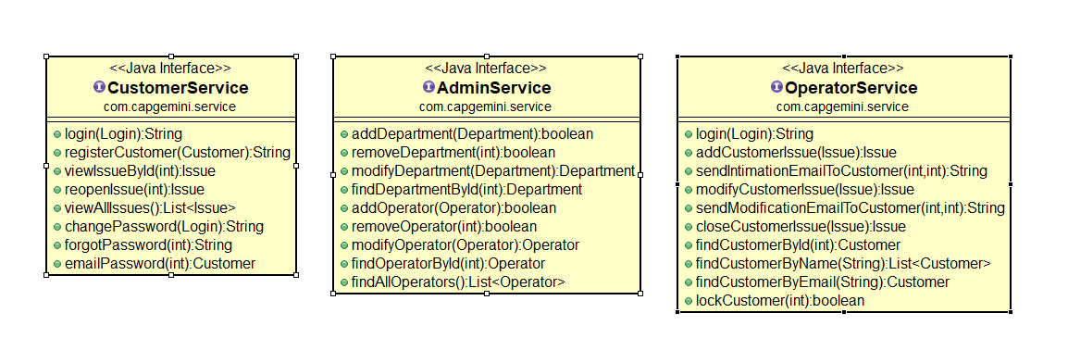
Class Design
Service Interface:

Slide 9
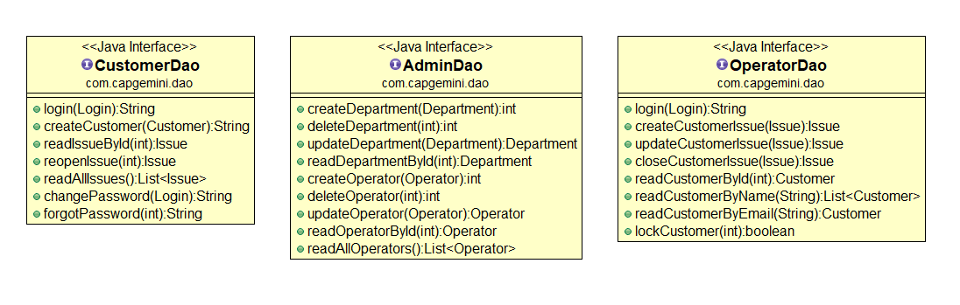
Class Design
Repository:

Slide 10




Questions

